Slide 1
AudioSpace
Responsive Navigation

Slide 2
Navigation is often tricky to style properly, but when it comes to responsive design, it becomes even tricker.
There are many approaches to navigation in responsive design. Here we will look at a fairly simple and effective option.
The top image shows the navigation we will add to the AudioSpace website displayed as it would if the screen is wide.
Below is an image of how the menu will look if the page is narrow.

Slide 3
The basic strategy is that both of these menu bars will be on the page the whole time.
When the page is wide, the top one is hidden. Then in the 600 px wide media query, we will hide the bottom one and show the top one.
The actual unordered list with list items and anchor tags will get reconfigured at this size to display vertically on the right.
Then we will use a tiny bit of JavaScript (jQuery) to toggle the view of the menu when you click the menu button.

Slide 4
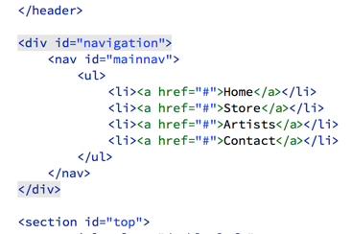
We can start by adding this basic markup for the navigation. I will explain later why we need the extra div around the whole thing.
It goes on the HTML file after the header and before the top section.

Slide 5
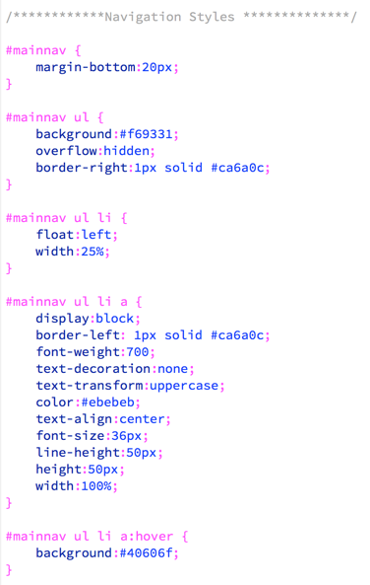
Here are some basic styles that can go on the stylesheet. I put them after the logo styles section of the stylesheet, but they can really go anywhere above the media queries.
There is nothing remarkable about these rules. This is all stuff you have done before. I intentionally wanted the navigation to be fairly simple for this example.

Slide 6
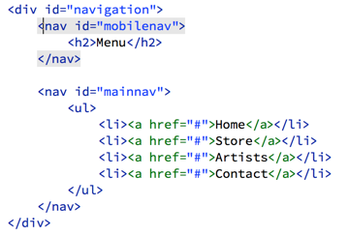
You can see, that with these styles in place, we have a standard navigation bar that matches our design.
Next we need to add the mobile navigation bar.
Add the mobilenav as shown on the right to the top of the navigation div.

Slide 7
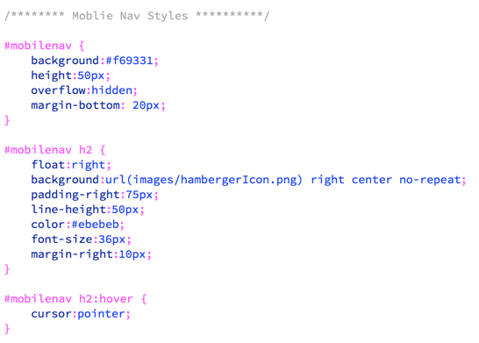
Add these styles to the stylesheet after the navigation styles we just added. These rules will style the mobile nav bar.
If you look at the page now you will see both nav bars.

Slide 8
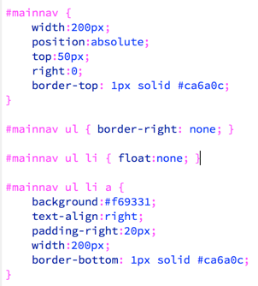
Add these rules to the bottom of the mobilenav section, temporarily. We will move them to the media query later, but for now, we need them here so we can see what we are doing.
If you view the page, it should look like this...
Notice, in the #mainnav rule above, we are positioning the element absolutely, which is currently positioned relative to the WINDOW. I want it to be relative to the NAVIGATION element. This is why I had you add the additional #navigation div.

Slide 9
Add this rule so that the #mainnav positions relative to this parent element. I put it at the top of the navigation rules, but it really could go anywhere.
That will put the mobilenav in the correct spot. Now we just need to move rules to the media query and make it display the correct menu at the correct time.

Slide 10
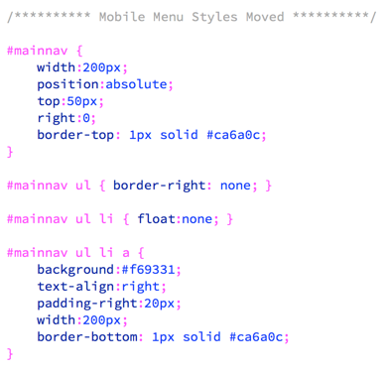
MOVE these four rules to the bottom of the 600 pixel media query. If you test the page, you will see we are getting closer, when you resize the window.

Slide 11
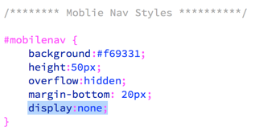
Next we hide the #mobilenav when the window is wider than 600 pixels. Add this display:none declaration to the mobilenav rule in the mobile nav section of the stylesheet (not in the media query).
But then you will notice that when the page is less than 600px wide, it is still hidden. Add this rule in the 600px wide media query to fix that.

Slide 12
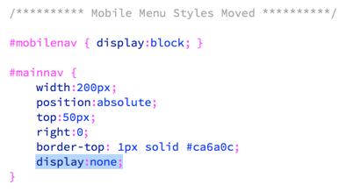
That should be working. Now we just need to hide the menu items, then trigger them to open and close when you click the menu button at the top.
To do this, simply add display:none to the #mainnav rule in the 600px wide media query. It will be hidden now.

Slide 13
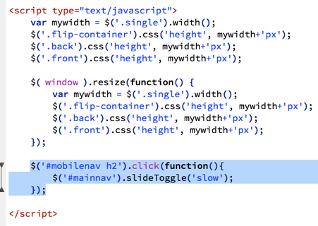
To toggle the menu on and off, simply add this tiny bit of jQuery to the bottom of the script tag, at the bottom of the HTML file.
This function says, when you click the H2 in the mobilenav, show the mainnav, if it is hidden, or hide it if it is showing.
We are basically done, but there are a few little glitches to fix.
You will notice that if you open and close the mobile menu, then resize the window to wide the menu disappears altogether. What???
This is because we closed the menu, which hid it, and when we make the page wide, it is still hidden. Not too many people will be shrinking and stretching their browser windows, but this is an easy thing to fix, so we might as well do it.

Slide 14
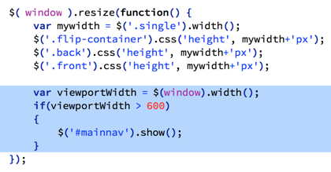
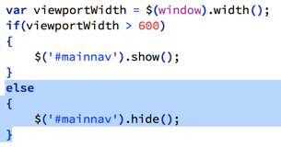
We already have a function that is watching the resizing of the window. We can just add a little to that. This piece at the bottom will check to see if the window is wider than 600 pixels and then make sure the mainnav is showing.
That works, but now you will notice that if you shrink the window, open and close the menu, then grow the window, then shrink the window again, the menu is showing by default. This is because the script we just added is telling it to show (overriding the stylesheet).
We can fix that with a simple else statement.
Whew, done!

